Slide 2
Image Changes
In temporal direction of the Local and Global features
Refers to the change in,
Local/Global scale, shift, rotation etc.
Local/Global color, Illumination, brightness, contrast etc.

Slide 3
Local Changes

Slide 4
Local Changes
In temporal direction
Refers to the change in,
local scale, shift, rotation etc.
local Illumination, brightness, contrast etc.

Slide 5






Feature Encoder (Spatial Attention) (ViT)
Pose Encoder (GCN or Transformer-based)
Root joint features
Local image features
t-4
t-3
t-2
t-1
t
t-4
t-3
t-2
t-1
t
Encoder (Temporal Attention)
Targets & Predictions
Encoder (Temporal Attention)
t+5
t+4
t+3
t+2
t+1
t
Transformer Decoder (Custom)
Global image features
Root-relative pose features
Linear Projection

Slide 6
Temporal Attention
Goal is to answer the following questions.
Where and how did each local feature evolve from?
Where and how will each local feature evolve to?
Two keywords representing temporal direction.
From → Cause
To → Effect

Slide 7




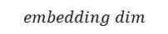
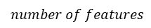
Temporal Attention
Simple case
$$t=x$$
$$t=y$$
$$embedding dim$$
$$number of features$$
$$Query$$
$$Key \& Value$$

Slide 8
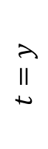


Temporal Attention
Generate attention coefficient matrix
$$t=y$$
$$Key$$
$$t=x$$
$$Query$$

Slide 9

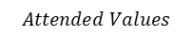

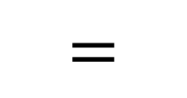

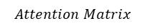
Temporal Attention
Multiply attention coefficients with the value
$$Attention Matrix$$
$$t=y$$
$$×$$
$$=$$
$$Value$$
$$Attended Values$$

Slide 10




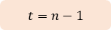

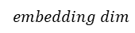

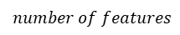
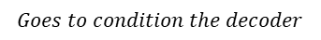


Temporal Attention
Original Set of Features
Attended Set of Features
Example Forward “Temporal” Attention (in detail)
Final Output
$$t=n−1$$
$$t=n$$
$$Key \& Value$$
$$Key \& Value$$
$$embedding dim$$
$$number of features$$
+
=
+
=
$$Goes to condition the decoder$$
$$Query$$
$$Query$$
$$t=n−2$$
$$t=n−1$$
$$t=n$$
$$Attended Values$$
$$Attended Values$$

Slide 11
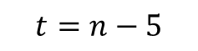
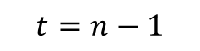
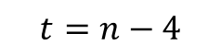
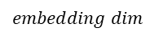
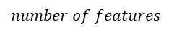
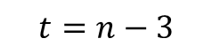

Temporal Attention
Forward “Temporal” Attention
$$t=n−5$$
$$t=n−4$$
$$t=n−3$$
$$t=n−1$$
$$t=n$$
$$embedding dim$$
$$number of features$$
To Decoder

Slide 12
Temporal Attention
Backward “Temporal” Attention
$$t=n−5$$
$$t=n−4$$
$$t=n−3$$
$$t=n−1$$
$$t=n$$
$$embedding dim$$
$$number of features$$
To Decoder

Slide 13
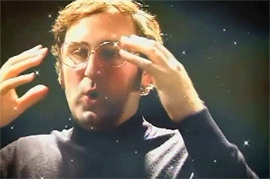
Temporal Attention
Forward & Backward “Temporal” Attention
$$t=n−5$$
$$t=n−4$$
$$t=n−3$$
$$t=n−1$$
$$t=n$$
$$embedding dim$$
$$number of features$$
To Decoder

Slide 14
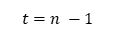

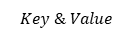
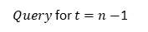

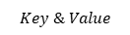

$$Query$$
$$Key \& Value$$
$$Query$$
$$Key \& Value$$
Local features of either poses or images
Spatio-temporal encodings of images
Spatio-temporal encodings of poses
$$t=n$$
$$t=n −1$$
Backward Attention
Cross Attention
+
For Dual-Conditioning
$Query$ for $t=n−$1

